Slide 1
experiment: Detecting Biotech corn USING PCR BIOTECHNIQUES

Slide 2
Plant Biotech Technologies Testing if a New Inserted Gene is in the Plant Cells
Questions must be answered by Plant Biotech Scientists at Dow AgroSciences
During gene transfer, did the gene become incorporated into the plant genome ?
Test: DNA Test to detect the gene, typically PCR
Is the protein functioning?
Test: Protein expression, typically an ELISA test
Does the plant still function properly, physically appear the same
Test: Field Phenotyping, Crop Yield data
To produce a biotech crop to product (sell to market) can take 10-15 years and must pass all FDA regulations and trials.
Biotech Crops Background: Bio-Rad Website (unbiased)
http://www.bio-rad.com/evportal/evolutionPortal.portal?_nfpb=true&vertical=LSE&country=US&lang=en&_pageLabel=ProductsLandingPage&catID=1457

Slide 3
DNA Amplification by PCR, Detecting the Gene
DNA is a relatively stable molecule, thus DNA fragments can be isolated from highly processed foods and are sufficiently intact to be amplified by PCR.
DNA that have been inserted into the Biotech plant can be detected by using specific primers for the inserted gene.
PCR is the most common and basic test used for rapid gene detection
WEBSITES of Tutorials on PCR
http://www.maxanim.com/genetics/PCR/PCR.htm
http://users.ugent.be/~avierstr/principles/pcr.html
http://www.youtube.com/watch?v=ZmqqRPISg0g
http://www.bio-rad.com/LifeScience/jobs/2004/04-0522/04-0522_PV92_PCR.html

Slide 4
Basic Principles of PCR Reaction
WHAT IS PCR???
Definition of PCR (polymerase chain reaction) :
A method that allows exponential amplification of short DNA sequences (usually 100 to 600 bases) within a longer double stranded DNA molecule using a DNA polymerase enzyme that is tolerant to elevated temperatures
PCR is used to amplify a specific region (sequence) of a DNA strand (the DNA target) within a genome.
The amount of amplified product is determined by the available substrates (reagents) in the reaction, which become limiting as the reaction progresses.
Typically, PCR consists of a series of 20-40 repeated temperature changes, called cycles, with each cycle commonly consisting of 2-3 discrete temperature steps, usually three .

Slide 5
Basic Principles of PCR Reaction
PCR entails the use of a pair of primers, each about 20 nucleotides in length, that are complementary to a defined specific sequence on each of the two strands of the DNA within the genome.
These primers are extended by a DNA polymerase so that a copy is made of the designated sequence.
Since it is necessary to raise the temperature to separate the two strands of the double strand DNA in each round of the amplification process, a thermo-stable enzyme is needed called DNA polymerase (Taq polymerase)
This enzyme was isolated from Thermus aquaticus, a bacterium that grows in hot pools, as a result it is not necessary to add new polymerase in every round of amplification.

Slide 6
Components of PCR Reaction
Template –
the DNA region (target) to be amplified, typically a genome of a species which the DNA was isolated /extracted from
In this experiment, the Corn DNA is the template
Primers –
Two primers that are complementary to the 3’ ends of each of the sense (forward primer) and anti-sense (reverse primer) strand of the DNA target.
Primer sequences are unique to the genome sequence of interest
F Forward Primer, unique sequence which targets the DNA template
R Reverse Primer,
Nucleotides (Deoxynucleoside triphosphates ) -
the building-blocks from which the DNA polymerase synthesizes a new DNA strand.
dATP, dCTP, dGTP, dTTP

Slide 7
Components of PCR Reaction
Magnesium chloride - Divalent cations which act as an enzyme co-factor
Buffer –
Provides a suitable chemical environment for optimum activity and stability of the DNA polymerase.
Its pH changes very little when a small amount of strong acid or base is added to it and thus it is used to prevent changes in the pH of a solution.
The pH of the PCR reaction is important for the enzyme (taq polymerase) to function properly
Maintains pH & contains salt (NaCl₂) which also reactions with MgCl₂
Taq DNA polymerase – thermophillic enzyme from hot springs
An enzyme able to withstand the protein-denaturing conditions with a temperature optimum at around 70 ⁰C required during PCR
The enzyme which adds the dNTP’s to the single stranded DNA template after denaturation of double stranded DNA

Slide 8
Definition of a Biplex PCR Reaction
Biplex PCR:
Consists of multiple primer sets within a single PCR mixture to produce amplicons (amplified DNA fragments which correspond to the bands on the gel) of varying sizes that are specific to different DNA sequences.
In this Biplex PCR reaction, a primer set for the internal control corn gene Invertase and a primer set for the biotech (GMO) gene, CamV35S Promoter, are in the SAME master mix reaction tube.
By targeting multiple genes at once, additional information may be gained from a single test run that otherwise would require several times the reagents and more time to perform
In this PCR Biplex reaction, the internal control gene and the biotech (GMO) gene will both amplify if the sample is positive.
Specific primers for invertase
Specific primers
For biotech gene (CamV35S)

Slide 9
Experiment Design: Biplex PCR Reaction
Each PCR set-up will include:
Positive control:
known positive DNA sample which came from a biotech traited (GMO) corn plant
Negative control:
known negative DNA sample which came from a wild-type or non-GMO corn plant
Two Unknown DNA samples: Testing samples
Blank – water blank which ensures no contamination in the PCR set-up
Master Mix I (MMI) Components:
PCR Buffer and Water – aides in stabilizing the pH of the PCR solution
dNTP’s – building blocks for the taq polymerase to make new DNA strands
Two Sets of sequence specific primers
Set 1: Forward and Reverse primers of:
the Invertase gene (corn genome internal control gene)
Set 2: Forward and Reverse primers of:
the CamV35S Promoter gene (biotech GMO gene)
Taq polymerase - enzyme which adds the dNTP’s to the single stranded DNA template after denaturation of double stranded DNA

Slide 10
Experiment Design: Thermocycler Conditions
Steps in PCR :
Initial Denaturation: consists of heating the reaction to a temperature of 94–98 ⁰C, held for 1–10 minutes.
It is required for DNA polymerases that require heat activation by Hot Start PCR
Provides sufficient time to denature the DNA (separate the double-stranded DNA)
Denaturation:
The first regular cycling step and consists of heating the reaction to 94–98 ⁰C, for 20–30 seconds.
It causes DNA melting (separation) of the DNA template by disrupting
the hydrogen bonds between complementary bases, yielding single-stranded DNA molecules.
Annealing:
The second cycling step where the temperature is lowered to 50–65⁰C ,
for 20–40 seconds allowing annealing of the primers to the single-stranded DNA template.
The annealing temperature is about 3–5⁰C below the Tm of the primers used.
Stable DNA–DNA hydrogen bonds are only formed when the primer sequence
very closely matches the template sequence.
The polymerase binds to the primer-template hybrid and begins DNA formation.

Slide 11
Experiment Design: Thermocycler Conditions
Steps in PCR :
Elongation:
The third cycling step, the temperature is 72⁰C, for 30s to 1 minute is commonly used with taq polymerase.
The temperature at this step depends on the DNA polymerase used; Taq polymerase has its optimum enzyme activity temperature at 75–80⁰C
The time at this step depends on the size of the DNA fragment being amplified
A smaller fragment (<500bp) typically uses a 30s to 1 min. elongation time
A larger fragment (> 500bp), typically can use 1 to 5 min. elongation time
At this step the DNA polymerase synthesizes a new DNA strand complementary to the DNA template strand by adding dNTPs that are complementary to the template in 5' to 3' direction, condensing the 5'-phosphate group of the dNTPs with the 3'-hydroxyl group at the end of the nascent (extending) DNA strand.
Final Elongation:
This single step is performed at a temperature of 70–74⁰C for 5–15 minutes after the last PCR cycle to ensure that any remaining single-stranded DNA is fully extended.

Slide 12
Experiment Design: Thermocycler Conditions
The three PCR cycles of Denaturation, Annealing and Elongation are repeated to amplify the DNA sequences between the specific primer sequences exponentially.
The # of cycles is typically between 30-40 cycles
Definition of 3 Stages in PCR :
Exponential amplification:
At every cycle, the amount of product is doubled (assuming 100% reaction efficiency). The reaction is very sensitive: only minute quantities of DNA need to be present.
Leveling off stage:
The reaction slows as the DNA polymerase loses activity and as consumption of reagents such as dNTPs and primers causes them to become limiting.
Plateau:
No more product accumulates due to exhaustion of reagents and enzyme.

Slide 13
Experiment Details: DNA Amplification by PCR, biplex reaction
PCR Reaction:
The table below shows the components of the Master Mix
Corn PCR Set-up Multiplex RXN:
Reagent | # Samples | Amt uL | Total
10xBuffer | 20 | 2.5 | 50
MgCl |  | 1 | 20
dNTP's |  | 2 | 40
Primer F (10uM)-GOI |  | 0.5 | 10
Primer R (10uM)-GOI |  | 0.5 | 10
Primer F (10uM)_IC |  | 0.25 | 5
Primer R (10uM)-IC |  | 0.25 | 5
Taq |  | 0.25 | 5
H2O |  | 12.75 | 255
 | Totals | 20 | 400
PCR Parameters:
CYCLE | TEMP (⁰C) | TIME
Initial Denaturation | 96 | 10 minutes
Denaturation | 95 | 30 sec
Annealing | 58 | 30 sec
Elongation | 72 | 1 minute
Final Elongation | 72 | 10 minutes
Cool down | 4 | forever
30 to 35 cycles of steps in orange

Slide 14
Experiment Details: DNA Amplification by PCR, biplex reaction
Method and Results
The Biplex PCR reaction will amplify the CamV35S promoter sequence in the Biotech (GMO) corn and an internal control gene, invertase, in corn genome
If sample is POSITIVE , two band sizes will be visible
150 bp band = GENE Positive for biotech traited GMO corn
98bp band = Corn Control gene, Invertase
If sample is NEGATIVE, no biotech trait (GMO) detected, one band will be visible
98bp band = Corn Control gene, Invertase
All corn plants have the Invertase gene because it is a native gene within the corn genome.
Non-genetically modified corn is considered as “wild-type” or naturally occurring. Their genome has not been genetically modified by biotechnology
Biotech (GMO) Corn which have been genetically modified using biotechnology, will have the biotech gene inserted into the corn genome.

Slide 15
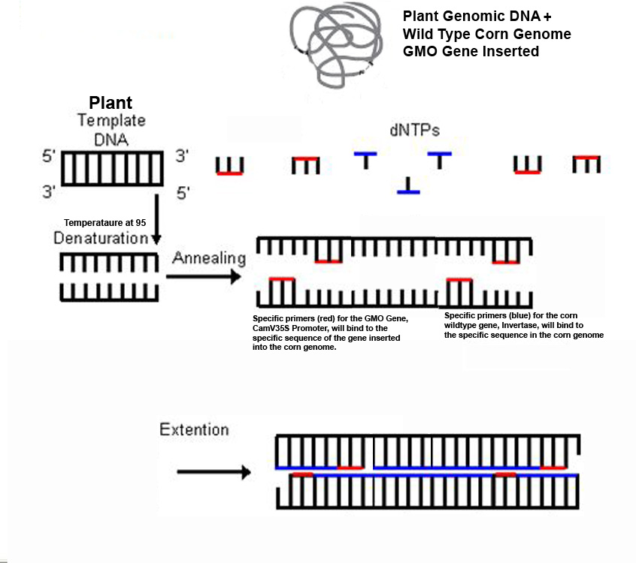
DNA, Primers, dNTP’s, taq polymerase and buffer
are all in one tube (master mix I or II)
Inserted biotech Gene Primers
CamV35S
dNTP’s
Corn Plant Primers
Invertase
Temperature ~ 60⁰C
During extension, dNTP’s are added
by Taq polymerase.
The process continues resulting
with specific amplification of the
Genomic sequences between the primers

Slide 16
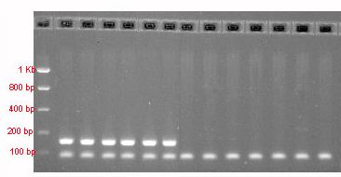
Results of DNA Amplification using MMI
Positive Sample: 2 DNA Fragments Amplified = 2 Bands
150 bp band : Detects the Biotech Gene (CamV35S )
98 bp band: Detects the Corn Invertase Gene
Negative Sample: 1 DNA Fragment Amplified = 1 Band
98 bp band: Detects the Corn Invertase Gene
All Corn Samples should have Corn Invertase Gene

Slide 17
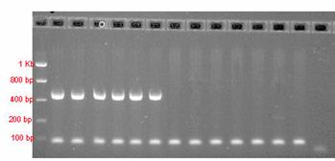
Results of DNA Amplification using MMII
Positive Sample: 2 DNA Fragments Amplified = 2 Bands
450 bp band : Detects the Biotech Gene (CamV35S )
98 bp band: Detects the Corn Invertase Gene
Negative Sample: 1 DNA Fragment Amplified = 1 Band
98 bp band: Detects the Corn Invertase Gene
All Corn Samples should have Corn Invertase Gene

