Slide 1
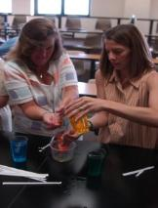
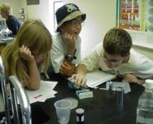
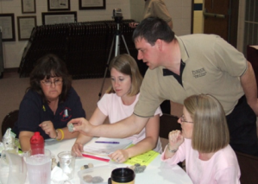
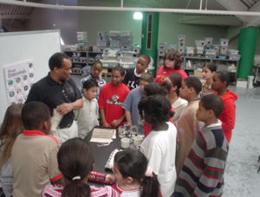
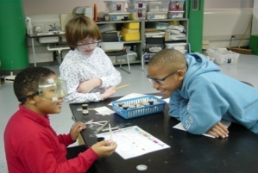
Broader Impacts: K-12
Partnering with K-12 is one way to address broader impacts in a research grant
Student programs
Teacher workshops
Curriculum development
School partnerships
Additional research
Scholarship of engagement

Slide 2
Broader Impacts: K-12
Jeff Trapp’s work for NSF using Doppler on Wheels radar (DOW) to collect data on severe weather included the creation of curricular materials and brought high school students to campus to learn about the equipment.
QuarkNET is sponsored by the National Science Foundation and the U.S. Department of Energy. Purdue’s QuarkNet Center has engaged high school physics teachers and their students in cutting-edge high energy particle physics research.
Aman Yadav, Tim Korb, and Susanne Hambrusch are working on an NSF program to create just-in-time teacher training modules for a first-year computer science course offered by Project Lead the Way funded through one of CISE’s education related programs: CE21
Using Science as the “Bonding” Agent” to Inquiry and Global Awareness was a three-year partnership with MSD Washington Township Schools. Teachers learned to use research-based science curricular modules and graduate students investigated the impact of the professional development on teachers.

Slide 3
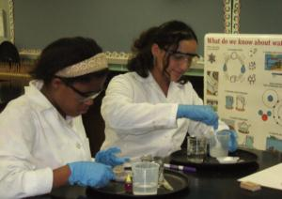
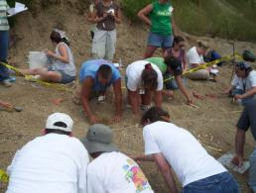
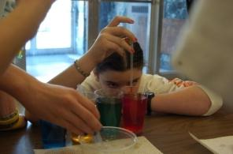
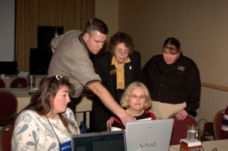
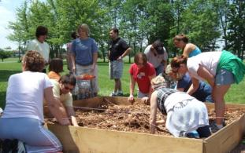
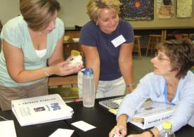
College of Science K-12 Outreach
Seven staff members representing COS Departments
Knowledgeable in research-based K-12 instruction, school culture, and educational policy
Manage ongoing outreach and engagement programs
Active state involvement
Indiana Department of Education
Professional Organizations
NSTA, NCTM, CSTA, NABT, ACS, AAPT
HASTI, ICTM, IABT, IACT, IESTA, INAAPT, ICE

Slide 4
College of Science K-12 Outreach
General | Bill Walker | wswalker@purdue.edu
Biology | Isidore Julien | julieni@purdue.edu
Chemistry | Bill Bayley | wbayley@purdue.edu
Computer Science | Phil Sands | psands@purdue.edu
Earth, Atmospheric, and Planetary Sciences | Steven Smith | mrsmith@purdue.edu
Mathematics/Statistics | Bill Walker | wswalker@purdue.edu
Physics | David Sederberg | dsederbe@purdue.edu
Science Express | Bill Bayley and Zach Grigsby | wbayley@purdue.edu zgrigsby@purdue.edu

Slide 5
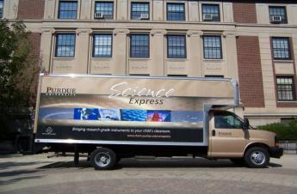
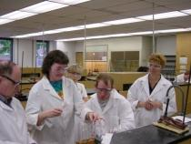
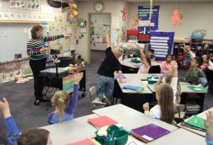
Suggestions for Work with K-12 Partners
Get to know your K-12 partners
Academic standards and accountability testing
Teacher evaluation programs
Leverage existing programs
Science Express
Science Express delivers research grade scientific instruments to high schools in Indiana
In 2012-2013 over 100 teachers participated with over 23,000 student-instrument interactions
School partnerships
Opportunities for scholarly work in K-12 engagement
Journal of Higher Education Outreach and Engagement
Journal of Community Engagement and Scholarship
Plan broader impact with K-12 early in the process and include funding

